Slide 1


Analysis on global Life Expectancy and Population
Anu Chandrasekar

Slide 2
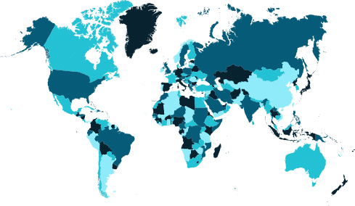
Agenda
Continent wise population growth
Country wise Life Expectancy
Gender wise Analysis of Medical Condition

Slide 3
Introduction
This comprehensive analysis explores critical global trends in population dynamics and life expectancy.
It is structured around three key agendas to provide a clear and insightful understanding of demographic and health patterns across the world.

Slide 4
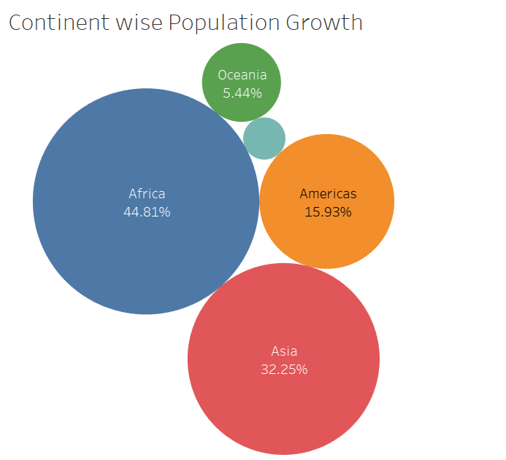
Continent wise population growth
This bubble chart visualizes continent-wise population growth percentages.
Each bubble's size represents the relative contribution of that continent to global population growth:

Slide 5
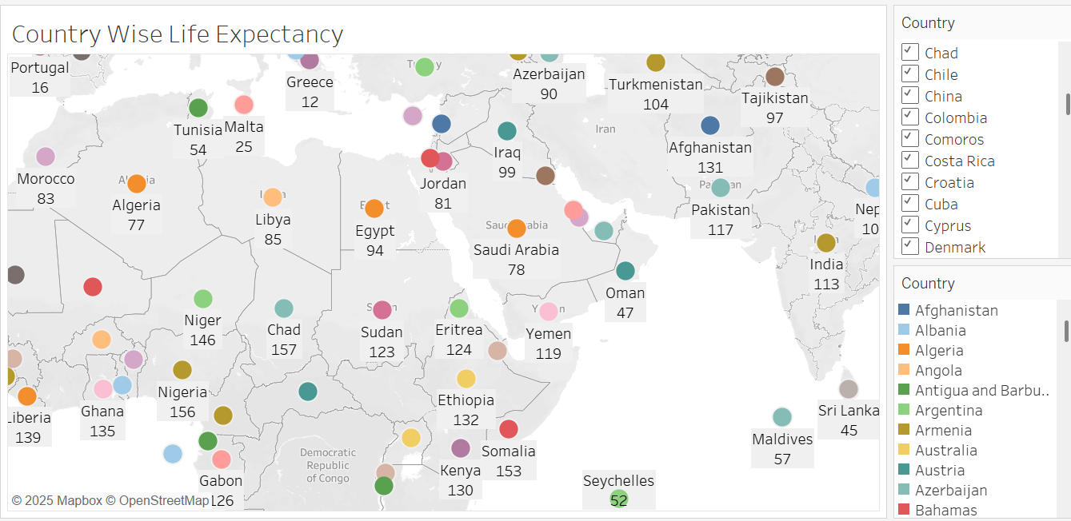
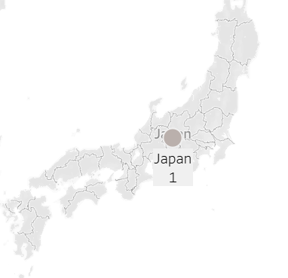
Country wise life expectancy
In the map-based visualization of country-wise life expectancy, Japan ranks highest, holding the 1st position, while Nigeria and Chad rank among the lowest at 156th and 157th respectively.

Slide 6
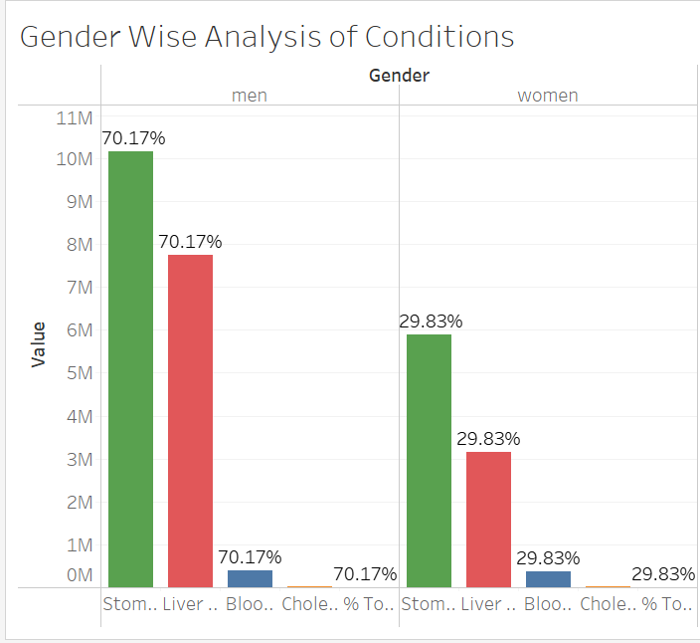
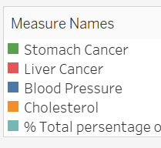
Gender Wise Analysis Of Condition
Stomach Cancer
Men:70.17% of Total cases
Women: 29.83% of Total cases
Insight:
Men are significantly more affected, accounting for over 70% of stomach cancer cases, highlighting a clear gender disparity.
Liver Cancer
Men: 70.17% of total cases
Women: 29.83% of total cases
Insight:
Like stomach cancer, men show a higher burden, with over 70% of liver cancer cases, indicating a consistent trend across these cancers.

Slide 7
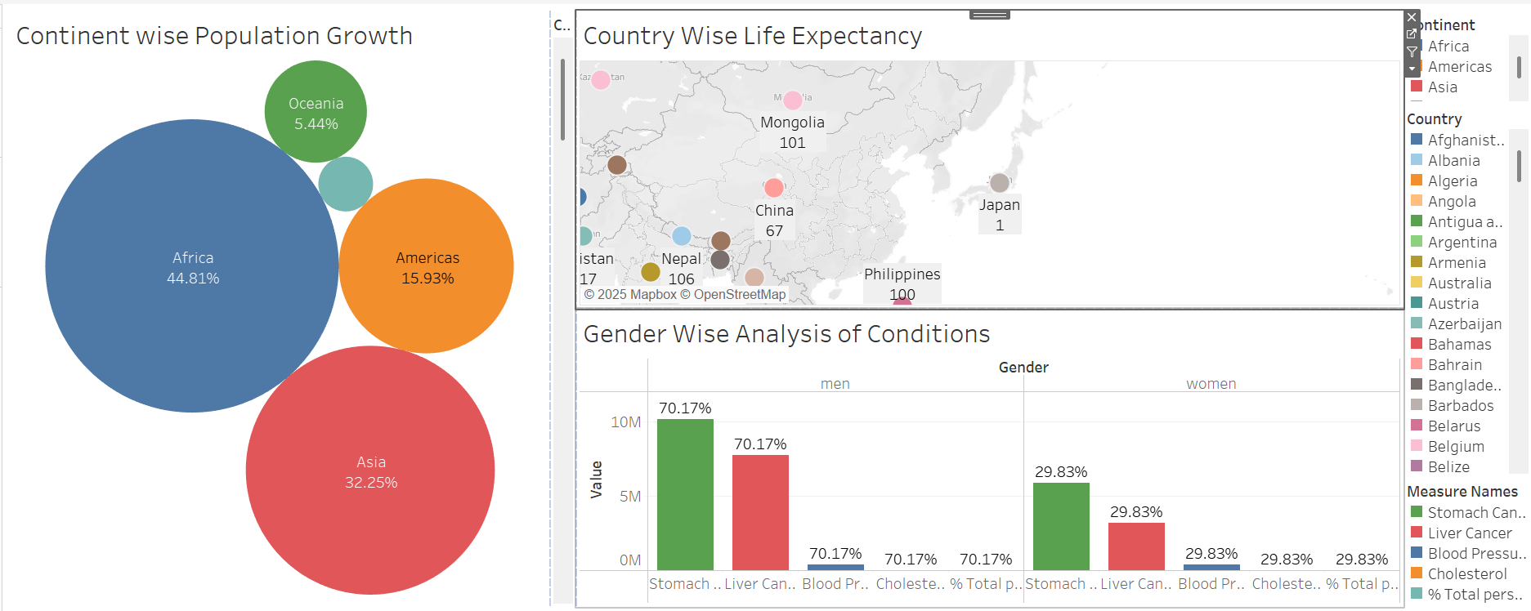
Analysis on global Life Expectancy and Population

Slide 8
Data story & INSIGHTS
Connecting the Dots: A Global Health Narrative
When we connect these insights, a clear narrative emerges.
Africa and Asia, which together account for 77% of global population growth, are regions where healthcare systems are often stretched thin.
In African countries like Chand and the Nigeria, where life expectancy is lower, the burden of diseases like stomach and liver cancer may be exacerbated by limited access to early diagnosis and treatment.
The gender disparity in health conditions, where men consistently bear a higher burden, suggests that men in these rapidly growing regions may be particularly vulnerable.
For example, in Asia, where liver cancer is often linked to high rates of hepatitis B (a major risk factor), men’s higher incidence could be tied to both biological and behavioural factors. In contrast, countries like Japan, with high life expectancy, likely have better mechanisms to manage these conditions, but the gender gap persists globally, indicating a universal challenge.

Slide 9
Data story & INSIGHTS
Conclusion: Implications and Call for Action
This data story reveals a world where population growth, life expectancy, and health conditions are deeply interconnected, with gender playing a critical role in health outcomes.
The rapid population growth in Africa and Asia calls for urgent investment in healthcare infrastructure to address rising disease burdens.
The gender disparity, where men are 70.17% of cases across stomach cancer, liver cancer, blood pressure, and cholesterol, highlights the need for targeted interventions, such as awareness campaigns aimed at men to reduce risk behaviours and encourage early screening.
Finally, the life expectancy divide reminds us that global health equity remains a distant goal, but one we can work toward by learning from leaders like Japan and Spain (Ranking 1st & 2nd ) supporting regions like Chand and Nigeria.
By addressing these challenges with gender-specific and region-specific strategies, we can move toward a healthier, more equitable world.

Slide 10
Thank you

